Slide 1
Modern Systems Analysis
and Design
Seventh Edition
Jeffrey A. Hoffer
Joey F. George
Joseph S. Valacich
Chapter 4
Managing the Information Systems Project

Slide 2
Learning Objectives
Explain the process of managing an information systems project.
Describe the skills required to be an effective project manager.
List and describe the skills and activities of a project manager during project initiation, project planning, project execution, and project closedown.
Explain what is meant by critical path scheduling and describe the process of creating Gantt charts and network diagrams.
Explain how commercial project management software packages can be used to assist in representing and managing project schedules.
Chapter 3
Copyright © 2014 Pearson Education, Inc. Publishing as Prentice Hall

Slide 3
Introduction
Project management (PM) may be the most important aspect of systems development.
Effective PM helps to ensure
  The meeting of customer expectations.
  The satisfying of budget and time constraints.
The nature of projects has changed from custom development to implementing packaged software and data warehousing.
PM skills are difficult and important to learn.
Chapter 3
Copyright © 2014 Pearson Education, Inc. Publishing as Prentice Hall

Slide 4
Managing the Information Systems Project
Project
  A planned undertaking of related activities to reach an objective that has a beginning and an end
Project management
  A controlled process of initiating, planning, executing, and closing down a project
Chapter 3
Copyright © 2014 Pearson Education, Inc. Publishing as Prentice Hall

Slide 5
Managing the Information Systems Project (cont.)
Project manager
  A systems analyst with a diverse set of skills—management, leadership, technical, conflict management, and customer relationship—who is responsible for initiating, planning, executing, and closing down a project
Deliverable
  The end product of an SDLC phase
Chapter 3
Copyright © 2014 Pearson Education, Inc. Publishing as Prentice Hall

Slide 6
Deciding on Systems Projects
System Service Request (SSR)
  A standard form for requesting or proposing systems development work within an organization
Feasibility study
  A study that determines whether a requested system makes economic and operational sense for an organization
Chapter 3
Copyright © 2014 Pearson Education, Inc. Publishing as Prentice Hall

Slide 7
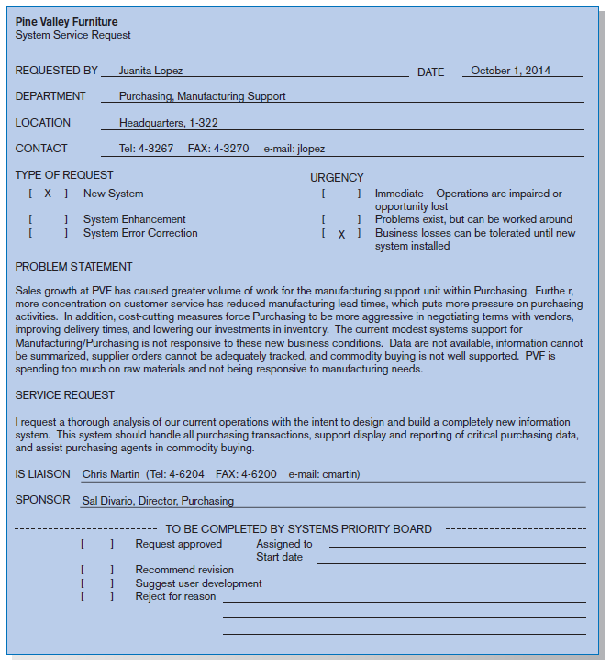
FIGURE 3-2
System Service Request for Purchasing Fulfillment System with name and contact information of the person requesting the system, a statement of the problem, and the name and contact information of the liaison and sponsor
Chapter 3
Copyright © 2014 Pearson Education, Inc. Publishing as Prentice Hall

Slide 8
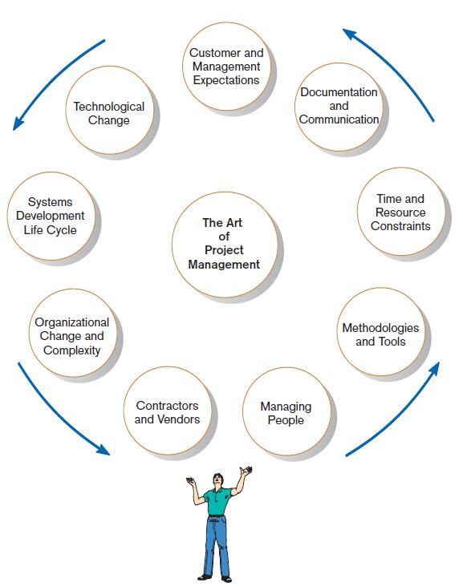
Project Management Activities
FIGURE 3-4
A project manager juggles numerous
activities
Chapter 3
Copyright © 2014 Pearson Education, Inc. Publishing as Prentice Hall

Slide 9
Phases of Project Management Process
Phase 1: Initiation
Phase 2: Planning
Phase 3: Execution
Phase 4: Closedown
Chapter 3
Copyright © 2014 Pearson Education, Inc. Publishing as Prentice Hall

Slide 10
PM Phase 1: Project Initiation
Assess size, scope and complexity, and establish procedures.
Establish:
  Initiation team
  Relationship with customer
  Project initiation plan
  Management procedures
  Project management environment and workbook
  Project charter
Chapter 3
Copyright © 2014 Pearson Education, Inc. Publishing as Prentice Hall

Slide 11
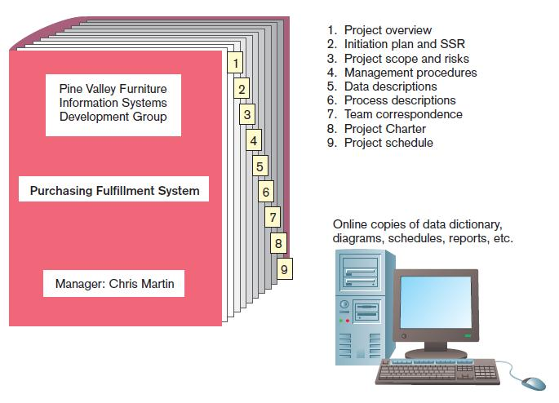
FIGURE 3-6
The project workbook for the Purchase Fulfillment System project contains nine key documents in both hard-copy and electronic form.
Chapter 3
Copyright © 2014 Pearson Education, Inc. Publishing as Prentice Hall

Slide 12
Project Charter
A short document prepared for the customer describing project deliverables and outlining the work required to complete the project
Elements:
  Title and authorization date
  Project manager name and contact information
  Customer name and contact information
  Project start and completion dates
  Key stakeholders, roles, responsibilities
  Project objectives and description
  Key assumptions
  Signatures of stakeholders
Chapter 3
Copyright © 2014 Pearson Education, Inc. Publishing as Prentice Hall

Slide 13
PM Phase 2: Project Planning
Define clear, discrete activities and the work needed to complete each activity. Tasks include:
Describing Project Scope, Alternatives, and Feasibility
Dividing the Project into Manageable Tasks
Estimating Resources and Creating a Resource Plan
Developing a Preliminary Schedule
Developing a Communication Plan
Determining Project Standards and Procedures
Identifying and Assessing Risk
Creating a Preliminary Budget
Developing a Project Scope Statement
Setting a Baseline Project Plan
Chapter 3
Copyright © 2014 Pearson Education, Inc. Publishing as Prentice Hall

Slide 14
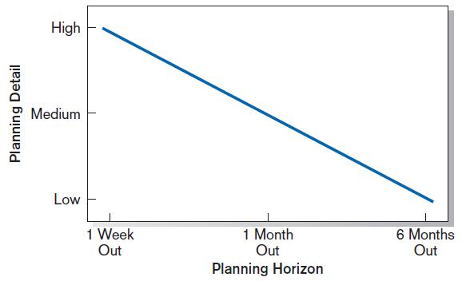
Planning Detail
FIGURE 3-8
Level of project planning detail should be high in the short term, with less detail as time goes on.
Chapter 3
Copyright © 2014 Pearson Education, Inc. Publishing as Prentice Hall

Slide 15
Project Scope, Alternatives, and Feasibility
What problem or opportunity does the project address?
What are the quantifiable results to be achieved?
What needs to be done?
How will success be measured?
How will we know when we are finished?
Chapter 3
Copyright © 2014 Pearson Education, Inc. Publishing as Prentice Hall

Slide 16
Dividing Project into Manageable Tasks
Work Breakdown Structure (WBS)
  Division of project into manageable and logically ordered tasks and subtasks
Scheduling Diagrams
  Gantt chart: horizontal bars represent task durations
  Network diagram: boxes and links represent task dependencies
Chapter 3
Copyright © 2014 Pearson Education, Inc. Publishing as Prentice Hall

Slide 17
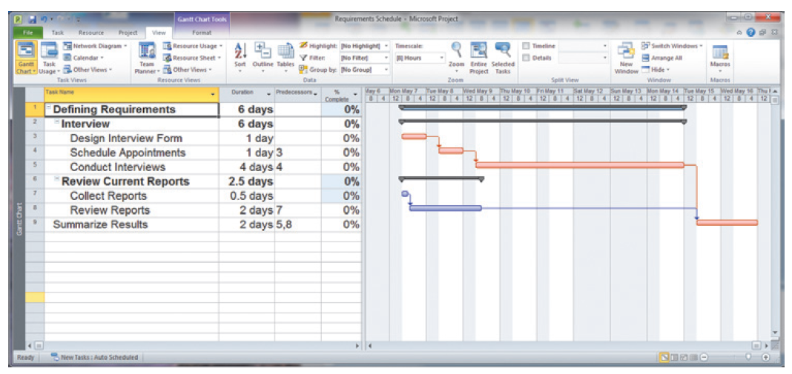
Developing a Preliminary Schedule
WBS
Gantt Chart
FIGURE 3-10
Gantt chart showing project tasks, duration times for those tasks, and predecessors
Chapter 3
Copyright © 2014 Pearson Education, Inc. Publishing as Prentice Hall

Slide 18
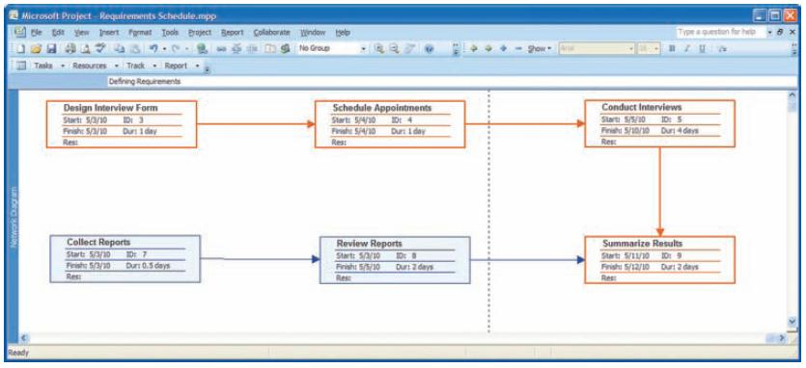
Scheduling Diagrams Network Diagram
FIGURE 3-13
A network diagram illustrating tasks with rectangles (or ovals) and the relationships and sequences of those activities with arrows (Source: Microsoft Corporation.)
Chapter 3
Copyright © 2014 Pearson Education, Inc. Publishing as Prentice Hall

Slide 19
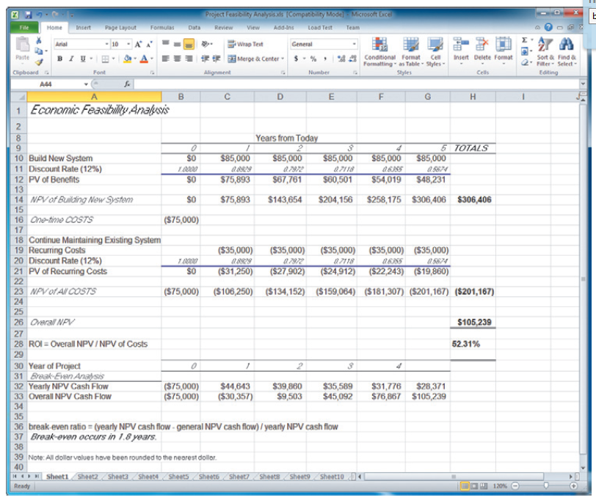
Developing a Preliminary Budget
FIGURE 3-15
A financial cost and benefit analysis for a systems development project (Source: Microsoft Corporation.)
Spreadsheet software is good for this.
Chapter 3
Copyright © 2014 Pearson Education, Inc. Publishing as Prentice Hall

Slide 20
Developing a Communication Plan
Who are stakeholders?
What information does each stakeholder need?
When should information be produced?
What are sources of information?
Who will collect, store and validate info?
Who will organize and document info?
Who is the contact person for each stakeholder?
What is the appropriate/best format for info?
What communication medium should be used?
Chapter 3
Copyright © 2014 Pearson Education, Inc. Publishing as Prentice Hall

Slide 21
Setting a Baseline Project Plan
A Baseline Project Plan provides an estimate of the project’s tasks and resource requirements and is used to guide the next project phase—execution. As new information is acquired during project execution, the baseline plan will continue to be updated.
Chapter 3
Copyright © 2014 Pearson Education, Inc. Publishing as Prentice Hall

Slide 22
PM Phase 3: Project Execution
Plans created in prior phases are put into action.
Actions
  Execute baseline project plan.
  Monitor progress against baseline plan.
  Manage changes in baseline plan.
  Maintain project workbook.
  Communicate project status.
Chapter 3
Copyright © 2014 Pearson Education, Inc. Publishing as Prentice Hall

Slide 23
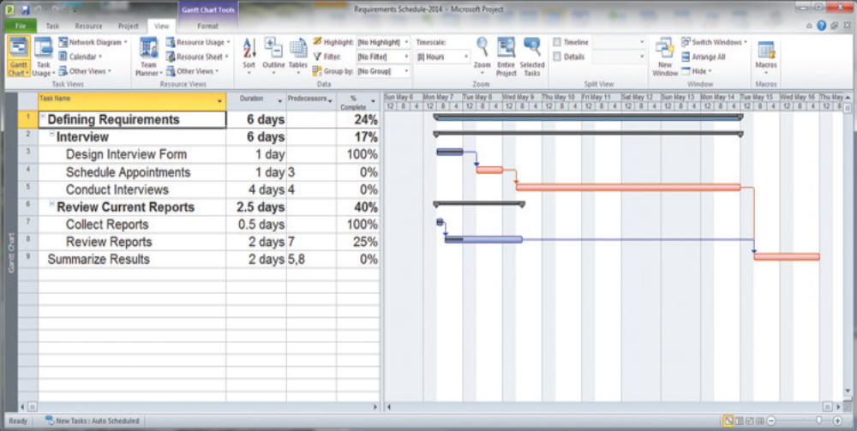
Monitoring Progress with a Gantt Chart
FIGURE 3-17
Gantt chart with tasks 3 and 7 completed and task 8 partially completed (Source: Microsoft Corporation.)
Red bars indicate critical path; lines through bars indicate percent complete.
Chapter 3
Copyright © 2014 Pearson Education, Inc. Publishing as Prentice Hall

Slide 24
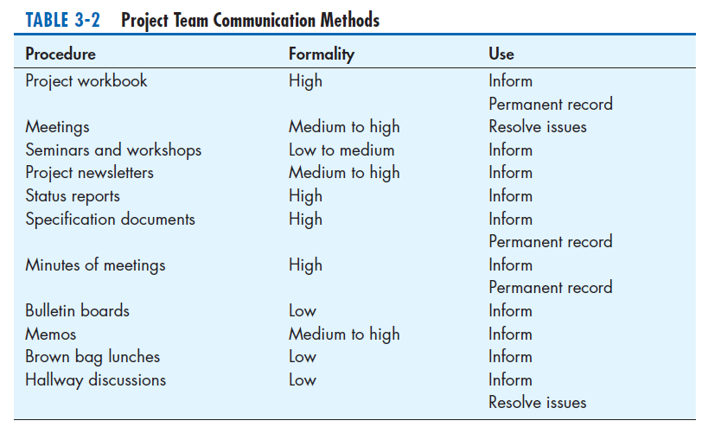
Communication Methods
Chapter 3
Copyright © 2014 Pearson Education, Inc. Publishing as Prentice Hall

Slide 25
PM Phase 4: Project Closedown
Bring the project to an end.
Actions
  Close down the project.
  Conduct post-project reviews.
  Close the customer contract.
Chapter 3
Copyright © 2014 Pearson Education, Inc. Publishing as Prentice Hall

Slide 26
Representing and Scheduling Project Plans
Gantt Charts
Network Diagrams
Project Management Software
Chapter 3
Copyright © 2014 Pearson Education, Inc. Publishing as Prentice Hall

Slide 27
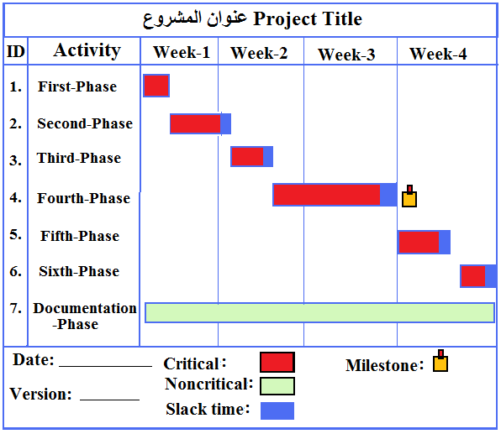
Gantt Chart: A graphical representation of a project that shows each phase as a horizontal bar whose length is proportional to its time for completion. Different shades, shapes or colors can be used to highlight different activities.

Slide 28
Important Definition
Slack Time: Amount of Time That an Activity Can Be Delayed Without Delaying The Project.
Duration: Amount of Time to Complete an Activity/Project.
Overlap: Two of more activities are done fully/partially in parallel
Milestone: used to indicate important dates on the project plan, often key events or goals.
Critical Task: if a change to its start date or duration affects the end date of the project

Slide 29
PERT
Program Evaluation Review Technique (PERT): is a technique that uses optimistic (o), pessimistic (p) and realistic (r) time estimates to calculate the expected time (ET) for a particular task.

Slide 30
Gantt Chart Diagram for Pine Valley Furniture
Steps
  1. Identify each activity
    Requirements collection
    Screen design
    Report design
    Database construction
    User documentation creation
    Software programming
    Installation and testing
3.<number>

Slide 31
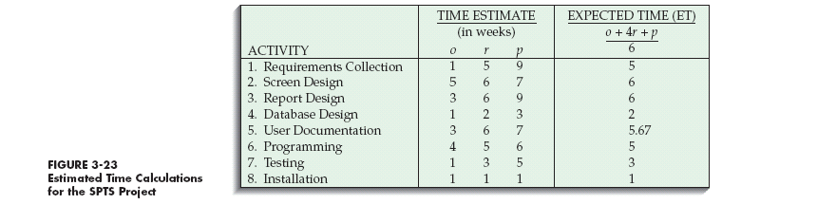
Gantt Chart for Pine Valley Furniture (continued)
  2. Determine time estimates and expected completion times for each activity
3.<number>

Slide 32
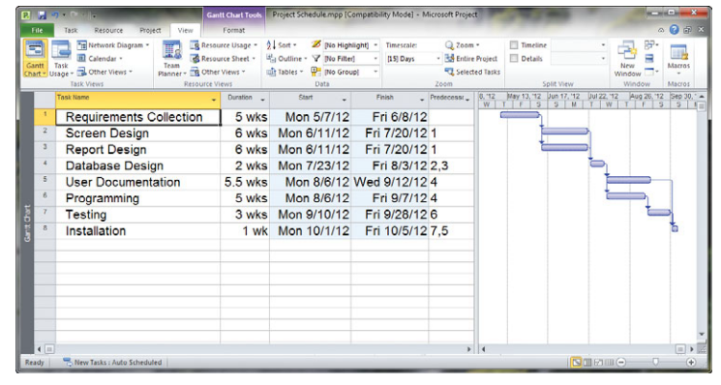
Gantt Chart for Pine Valley Furniture (continued)
3. Create the Gantt Chart

Slide 33
Homework
Use Gantt-chart to prepare project-plan for your project to be completed by the end of the current semester.

Slide 34
Gantt Charts vs. Network Diagrams
Gantt charts
  Show task durations.
  Show time overlap.
  Show slack time in duration.
Network diagrams
  Show task dependencies.
  Do not show time overlap, but show parallelism.
  Show slack time in boxes.
Chapter 3
Copyright © 2014 Pearson Education, Inc. Publishing as Prentice Hall

Slide 35
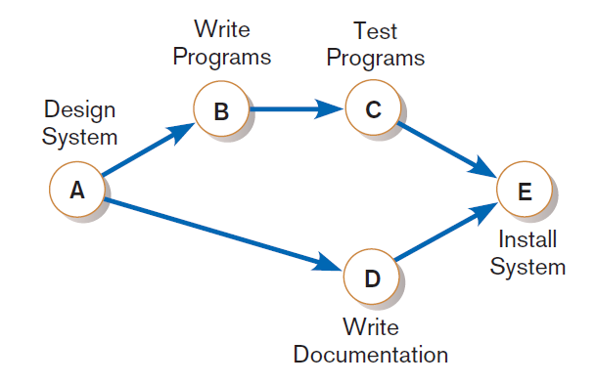
Gantt Charts vs. Network Diagrams (Cont.)
Figure 3-21
A network diagram showing activities
(represented by circles) and sequence of
those activities (represented by arrows)
Chapter 3
Copyright © 2014 Pearson Education, Inc. Publishing as Prentice Hall

Slide 36
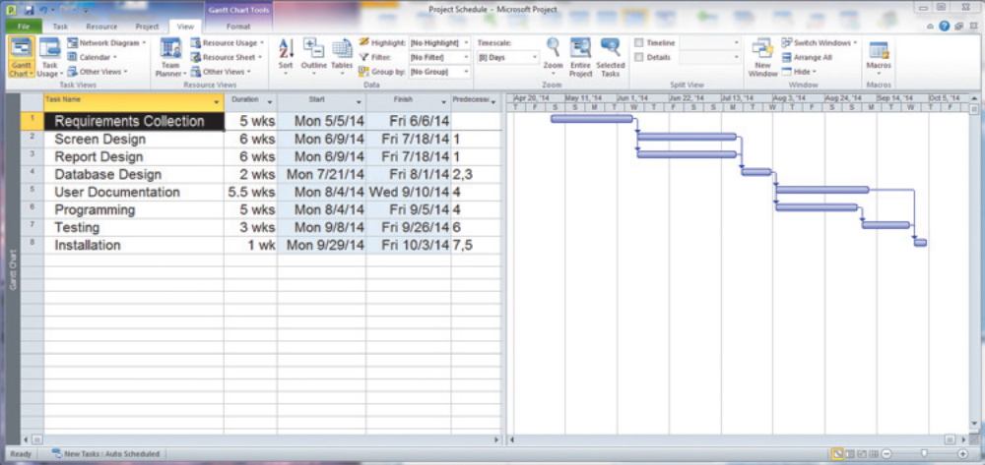
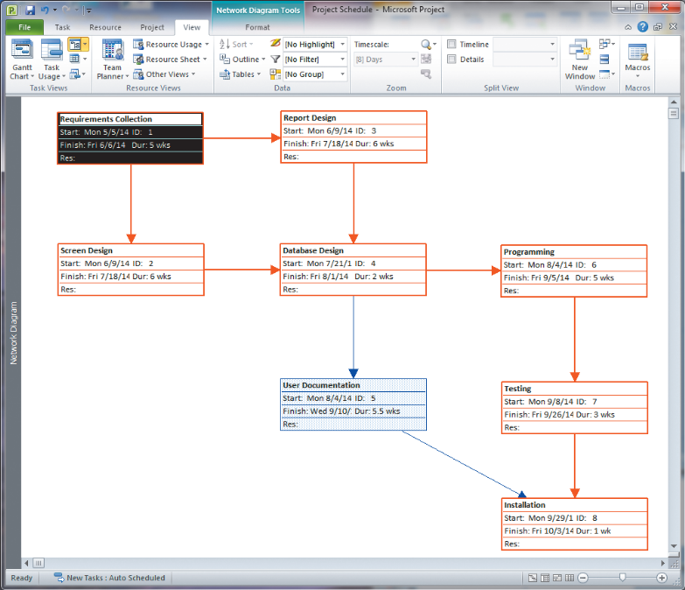
Gantt Charts vs. Network Diagrams (Cont.)
Figure 3-19
Graphical diagrams that depict project
plans
(a) A Gantt chart
(b) A network diagram
(Source: Microsoft Corporation.)
Chapter 3
Copyright © 2014 Pearson Education, Inc. Publishing as Prentice Hall

Slide 37
Using Project Management Software
Many powerful software tools exist for assisting with project management.
Example: Microsoft Project can help with
  Entering project start or end date.
  Establishing tasks and task dependencies.
  Viewing project information as Gantt or Network diagrams.
Chapter 3
Copyright © 2014 Pearson Education, Inc. Publishing as Prentice Hall

Slide 38
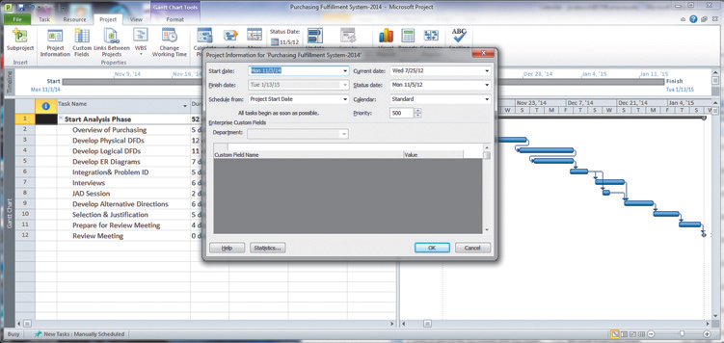
Project Start Date
FIGURE 3-28
Establishing a project starting date in Microsoft Project for Windows (Source: Microsoft Corporation.)
Chapter 3
Copyright © 2014 Pearson Education, Inc. Publishing as Prentice Hall

Slide 39
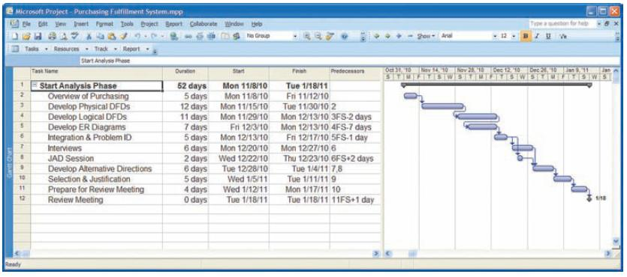
Entering Tasks
FIGURE 3-29
Entering tasks and assigning task relationships in Microsoft project
for Windows (Source: Microsoft Corporation.)
Chapter 3
Copyright © 2014 Pearson Education, Inc. Publishing as Prentice Hall

Slide 40
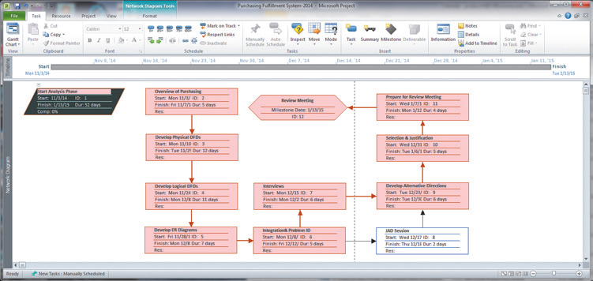
Viewing Network Diagram
FIGURE 3-30
Viewing project information as a network diagram in Microsoft Project for Windows (Source: Microsoft Corporation.)
Red boxes and arrows indicate critical path (no slack).
Hexagon shape indicates a milestone.
Chapter 3
Copyright © 2014 Pearson Education, Inc. Publishing as Prentice Hall

Slide 41
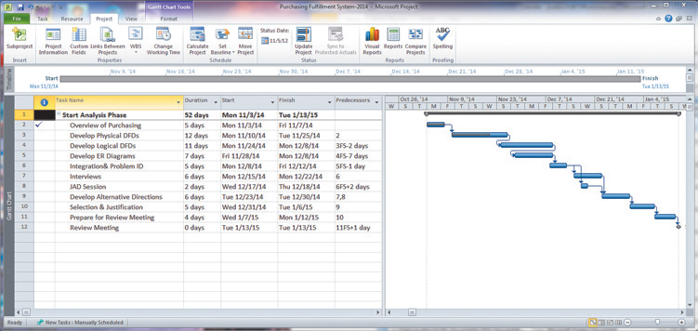
Viewing Gantt Chart
FIGURE 3-31
Gantt chart showing progress of activities (right frame) versus planned activities (left frame)
Black line at top indicates a summary activity (composed of subtasks).
Diamond shape indicates a milestone.
Chapter 3
Copyright © 2014 Pearson Education, Inc. Publishing as Prentice Hall

Slide 42
The End
11/08/26Chapter 3
Copyright © 2014 Pearson Education, Inc. Publishing as Prentice Hall

